Slide 1
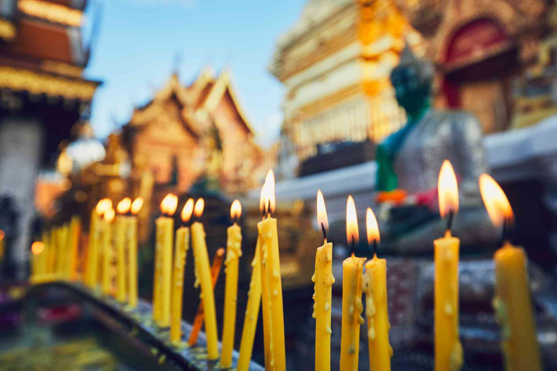
Making merit
Why is this such a good deed we normally practice?
What do we learn to do in our society?

Slide 2
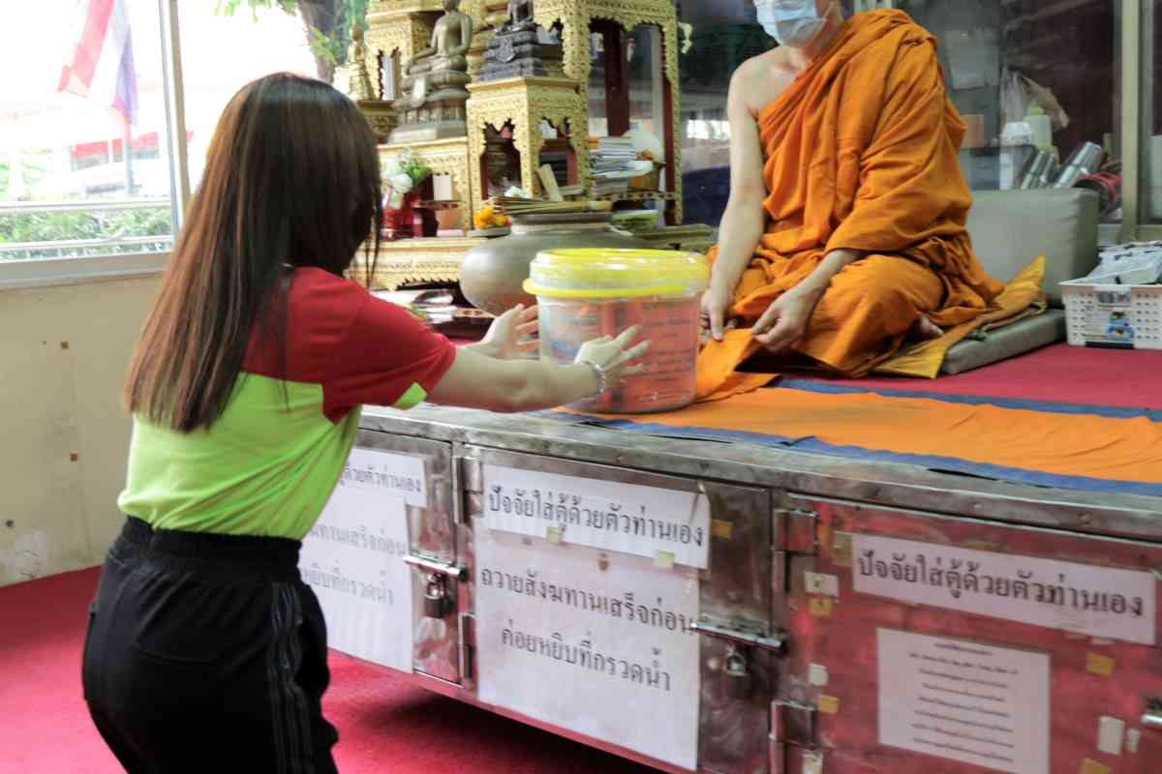
Making merit at a temple
You can go to and buy a variety of styles according to your needs.
Preparing a monk set : “Sangkhathan” as the “Offering of Sangha” then write complete details such as dedication to …………

Slide 3
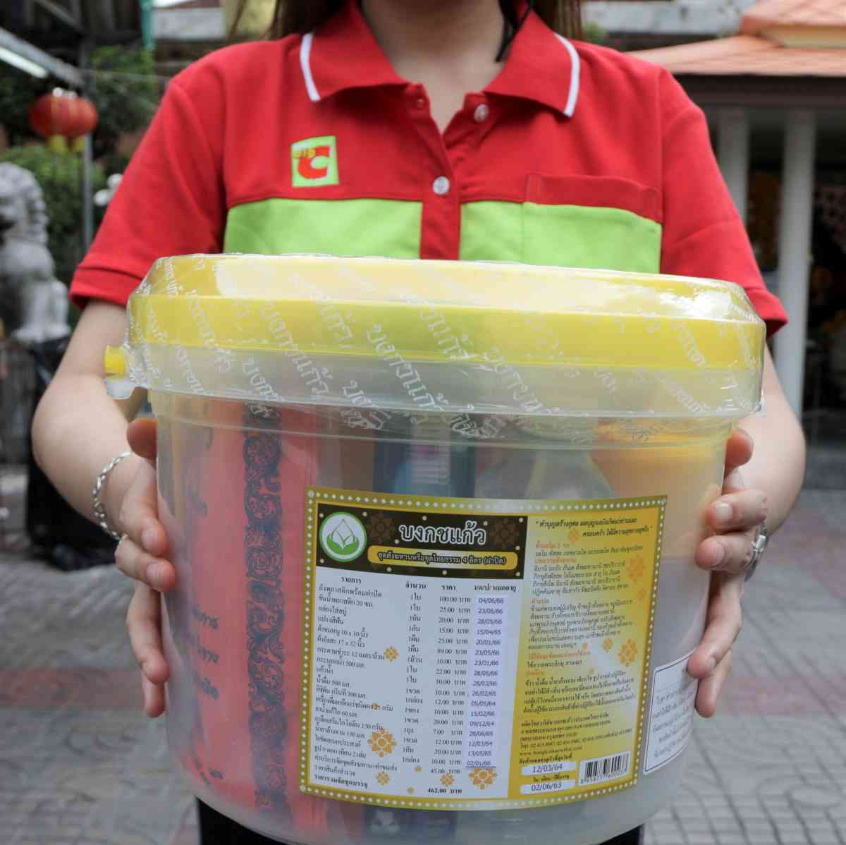
What should be offered?
Soap,
Toothbrush
Shampoo
Monk robe
Water
etc

Slide 4
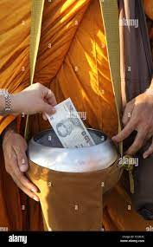
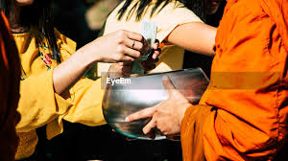
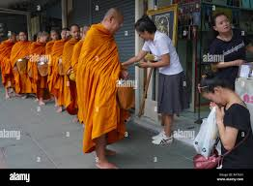
Discussion and Talk

Slide 5
Discussion
Question : Should we also give money to monk? For example, cash is included in the offering stuff. Sometimes, we even give the monk cash directly by hand.
Answer :
Discuss to explain some moral thoughts or lessons or virtues or sins, not general personal opinions/preferences

Slide 6
Should we also give money to monk?
Buddhist monks (bhikkhus) and nuns (bhikkhunis) are not allowed to accept money for themselves. Nor may monks or nuns buy and sell things for themselves using money. This is prohibited by the 19th rule in the Nissaggiya Pacittiya, one of the series of Vinaya.

